Slide 1
Floods

Slide 2
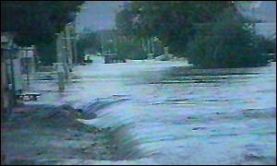
INTRODUCTION
A flood is usually caused by rain, heavy thunderstorms, and thawing of snow.
Its considered to be a temporary condition of two or more acres of dry land either:
Overflowed with inland or tidal waters
Rapid or runoff of surface waters
Mudflows

Slide 3
How does Flooding Start and end?
The shore or land by or surrounding a body of water erodes and this erosion causes waves currents that result in a flood.
Flood disasters have been increased because of the expansion of settlements and growth in floodplains.
Floods could be slow or fast but usually occur over a matter of days.
After the water eventually goes down or dries up. On coastal floods, low tides and high tides makes a change in heights.

Slide 4
Why does it occur??
A flood is too much water in the wrong place.
Sometimes a flood occurs from :
Sewer (drain) backup
Collapse of land along the shore of a lake or another body of water. This results in waves or currents during a flood

Slide 5
Where does flooding occur?
Flooding is the most worldwide natural disaster. It occurs in every country and wherever there is rainfall or coastal hazards.
They are most likely to happen in tropical areas and tsunamis.
Most common floods happen around the world’s largest/greatest rivers.
Believe it or not, smaller rivers could cause more damage even though people don’t pay as much attention to them.
Most Flooding occurs during the beginning of spring.

Slide 6
Characteristics of a Flood
A number of criteria determine the dangers of a flood. The University of Wisconsin have came up with the following criteria such as depth of water, duration, velocity, rate of rise, frequency or occurrence, and seasonal.
Velocity- high velocities of flow create erosive forces and can do things like destroy foundations.
Depth of Water- floatation, failures on foundation, vegetation survival, etc..
Rate of Rise- is the rate at which the water level increases.
Seasonal- the land during growing season, the effects on agriculture production and other things like that.

Slide 7
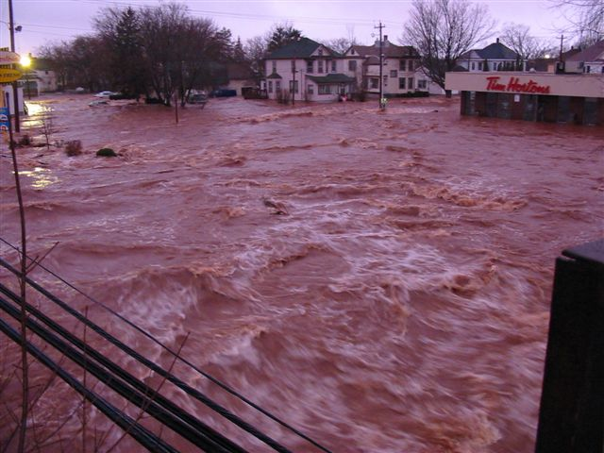
Precautions to Take
To remain safe from floods you need to know when and how to deal with them.
Lives could be saved by having more warnings of floods for places in threat.
There are things used for antiflood protection and it makes your house, yard and much more, safe and protected when a flood arrives. They can be used over and over again.

Slide 8



Flood Protection Equipment
This is a Door Flood Barrier. Its used to fit and seal your door.
This is a free standing door barrier. The difference with this one is you can still have use of the door as well.
Modular Flood Barrier is the highest level of protection . Its installed to protect your whole property from high bodies of water during a flood.

Slide 9
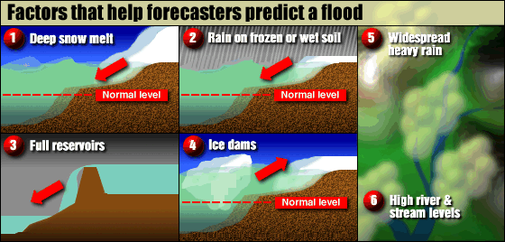
How Forcasters Predict Floods

Slide 10
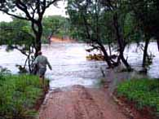
Predictions of a Flood
Deep Snow can melt into a lot of water. It usually floods because of rain or rapid warm temperatures.
Frozen ground won’t absorb as much water, the rain and/ or snow causes flooding on frozen ground.
Full reservoirs- Reservoirs are very big and are man-made to hold water for drinking or irrigation. It won’t absorb anymore water f full and it causes it to overflow.
High River or Stream Levels- melting flows into a full river and overflows on banks.

Slide 11
Government and Emergency Team Aid
There is an organization called World Meteorological Organization. It promotes flood management and water resources management. They have successfully guided and promoted international development of meteorology and hydrology. They give forecasts and warnings.
The government’s responsibility of fixing things during a flood are for example :damaged roads, buildings, telephones, and electricity.

Slide 12
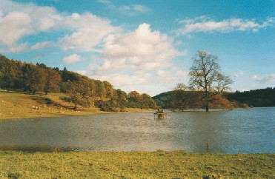
Effects on the Environment
Sometimes it’s a good thing when a flood occurs. The environmental benefits of flooding are fisheries, wetlands, and irrigation.
Flood plains have one of the highest development potential when it comes to economic development.
It also makes a mess of the environment. The soil becomes poor because the oxygen is limited due to so much water. The pH in soil decreases, rate decomposition of organic matter in flooded soil tends only to be half that unflooded soil
Trees are effected as well. It effects the height, age, vigor, roots, and species.
During the growing season flooding is very harmful especially to woody plants compared a flood in a dormant season.
Floods could carry chemicals from agricultural fields, sewage,etc. and can’t handle large bodies of water.
Crops die because they can’t survive because of the conditions.

Slide 13
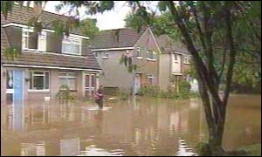

Flash Floods
Flash floods happen in a short time, they have a great volume of water, and are local floods.
The runoff of intense rain results in high flood waves.
Flash floods result in failure of dams and more.
It usually happens in desert areas and mountain regions.
They are a threat in steep land, high runoff rates, thunderstorms, and narrow streams.
This is a picture of a town after a Flash Flood

Slide 14
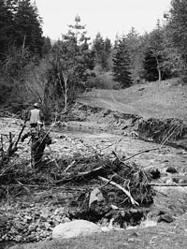
River Floods
Riverine floods are caused by melting of snow and precipitation over large areas. They take place in rivers. Floods in large rivers take hours to days.
The ground conditions effects the runoff.

Slide 15
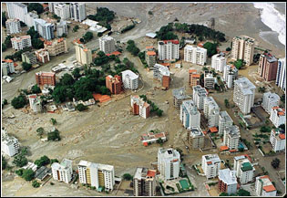
Coastal Floods
Coastal floods are caused by tides, storms, tropical cyclones, or tsunamis.
They happen in the ocean and effects the general public and maritime interests along the coastline.
They are caused by heavy surf, tidal piling, and storm surges,
Other factors are tidal cycles, behaviors of the storm, river or stream runoff, no offshore reefs or other barriers, and high winds.
Venezuela in December of 1999.

Slide 16
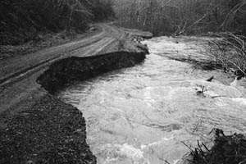
Urban Floods and Ice Jams
Urban floods are when the land is turned from fields or woods into roads and parking lots. Since this happens it can’t absorb the rainfall.
During the urban floods all the streets become rivers and basements become full of water, they are death traps.
Ice Jam is floating ice that adds up at a man-made or natural area and stops the flow of water. This causes the area to flood.

Slide 17
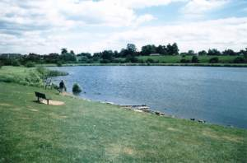
Lakeshore Floods
Lakeshore floods affect the general public as well as some areas of the Great Lakes.
These floods extend from the beaches to rivers that flow into lakes. The extent of the flooding is dependant on surrounding the shore terrain. The causes of these lakeshore floods are seiches in the Great Lakes.
The Webster dictionary’s definition of Seiches is:
The flow of periodically changing direction of the surface of a landlocked body of water (like a lake) that varies from a few minutes to several hours.

Slide 18
Deaths during Floods
Floods often result in death, especially along river banks and low-lying areas.
Floods kill more Americans than any other natural disaster each year. You may be surprised but only 6 inches of fast moving water can sweep a person off their feet and cars will float of move in only two feet of water.

Slide 19
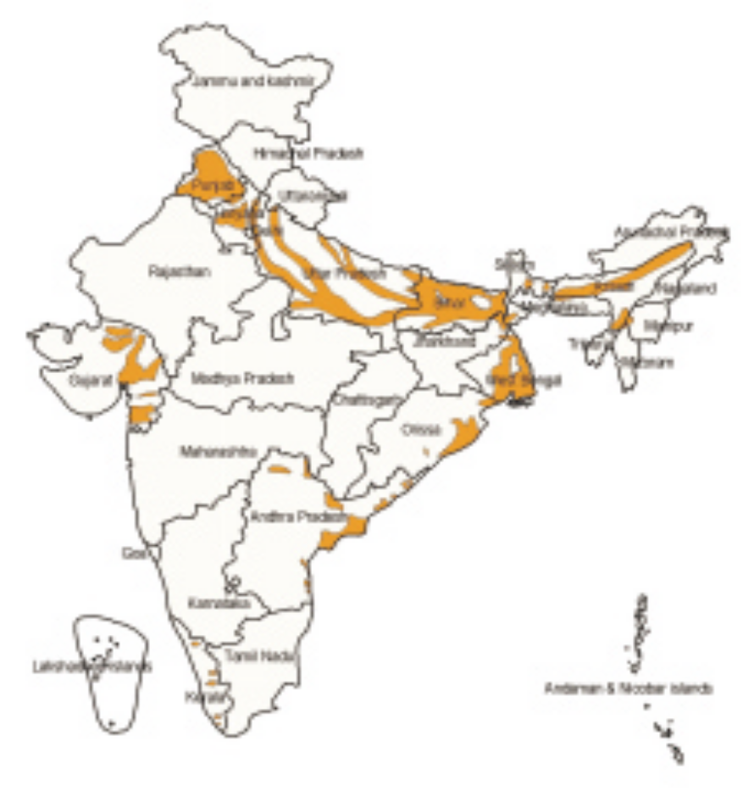
Distributional Pattern of floods in
India
Floods occur in almost all the river basins of the country. The Vulnerability Atlas of India shows pictorially the areas liable to floods. Around 12 per cent (40 million hectare) of land in India is prone to floods.
Most of the flood affected areas lie in the
Ganga basin, Brahmaputra basin
(comprising of Barak, Tista, Torsa,
Subansiri, Sankosh, Dihang and Luhit), the
northwestern river basin (comprising
Jhelum, Chenab, Ravi, Sutlej, Beas and the
Ghagra), peninsular river basin (Tapti,
Narmada, Mahanadi, Baitarani, Godavari,
krishna, Pennar and the Kaveri) and the
coastal regions of Andhra Pradesh,
Tamilnadu, orissa and Kerela. Assam, Uttar
Pradesh, Bihar and Orissa are some of the
states who have been severely prone to
floods.

Slide 20
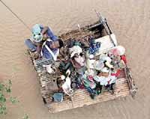
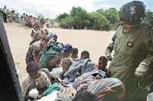
Mozambique, Africa Flood
In Mozambique on March 3rd, 2000 an awful flood had destroyed three villages.
Around 1 million people needed shelter, food, and medical care.
Thousands of people remained on roofs and rat-infested trees.
Rescuers had saved 12,000 people from flood waters after starving for a week.
15,000 remained in Save River Valley, stranded and nowhere to go.
The government has estimated 1 million people have been displaced by floods since the beginning of February 2000.

Slide 21




Bangladesh Flood
Bangladesh is a country with many rivers. Flooding in this area is common and necessary so it could fertilize from deposits of fresh alluvium.
Fresh alluvium is soil that is deposited by moving water.
In the fall of 1974 flooding was extended over one half of the country and stayed this way for over a month.
At least 1,200 people had died in the floods and 27,500 died from diseases and starvation. 425,000 houses were destroyed and destroyed agriculture. The cost of damages were 325.9 million in U.S.
36 million were effected by this huge flood.

Slide 22
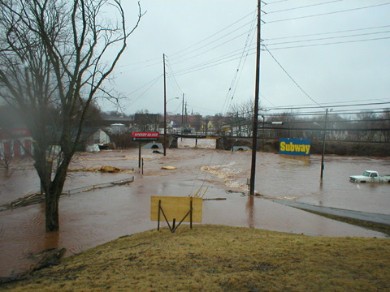
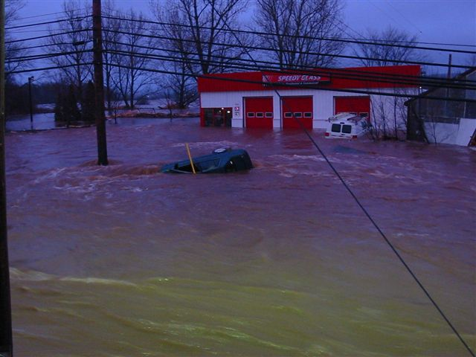

Slide 23
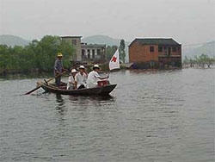
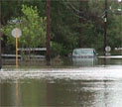
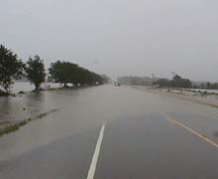

These are pictures of floods in Texas. It was the worst flood since 1998 in Texas. 22 people were killed
These are people from the red cross in China reaching victims in their boat.

Slide 24
The NSDU extension service says:
DURING A FLOOD
Listen to the radio for further information.
Fill bathtubs, sinks and jugs with clean water in case water becomes contaminated.
Bring outdoor belongings, such as patio furniture, indoors.
Move valuable household possessions to the upper floors or to safe ground if time permits.
If you are instructed by authorities, turn off all utilities at the main power switch and close the main gas valve.
Join with neighbors and volunteers to put sandbags or other protection in place. Stack sandbags away from the outside walls of houses to prevent floodwaters from entering.
Do not attempt to walk through moving floodwaters. If they are moving fast enough, water one foot deep can sweep you off your feet.
Do not attempt to drive over a flooded road. Turn around and go another way.

